Slide 1
Writing Queries
Jeremy Bergmann - Omaha Data Science Academy

Slide 2
Review: Class 1
What is the need for Data Manipulation & Management?
What is a database?
What is SQL? Why learn SQL if you know Python? What is ETL?
What is a table? How do you create a table? How do you insert data into a table? What are the most common SQL data types?
Notes:
Feynman technique: Learn -> Explain -> Reflect -> Repeat
What are the most important ideas from last class? Write a summary of the information as if explaining to a 14 year old. Avoid jargon Keep the words and sentences simple Rely on memory Make the explanation visual, if possible Note where you had difficulty or have knowledge gaps. These indicate things you should review, research, or ask questions about

Slide 3
Project Milestones
Import data into MySQL database (Class 1)
Query Data for Data Understanding/Relevant Information (Class 2)
Storing/Joining data for analysis (Class 3-4)
Cleaning Data (Class 5)
Normalize Data & Create Data Model (Class 6)
Analyze Data Quality & Create Data Dictionary (Class 7)
Connect Data to PowerBI Desktop/Cloud, Answer Business Questions Automate data workflow using ETL (Python - Optional) (Class 8)

Slide 4
Class 2 Objectives
Practice using common SQL clauses
Practice using common aggregations
Practice using comments for debugging or explaining code
Learn SQL functions
Practice writing subqueries
Practice using SQL by examples in MySQL Workbench
Notes:
Feynman technique: Learn -> Explain -> Reflect -> Repeat
What are the most important ideas from last class? Write a summary of the information as if explaining to a 14 year old. Avoid jargon Keep the words and sentences simple Rely on memory Make the explanation visual, if possible Note where you had difficulty or have knowledge gaps. These indicate things you should review, research, or ask questions about

Slide 5
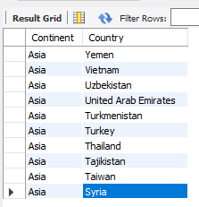
Example - World Query
Obtain a list of countries within the continent of Asia.
SQL Query
SELECT Continent, Name as Country #what columns to get
FROM world.country #what schema/table to read
Where Continent = 'Asia' #limit results”
ORDER BY continent, country DESC #Sort rows in result”
LIMIT 10 #number of rows to “bring back”
Notes:
Format for readability
FROM: what table to read
SELECT: what columns to get
AS: rename the column
GROUP BY: combine rows by column value
ORDER BY: sort in ascending or descending order
LIMIT: constrain the number of rows displayed

Slide 6
Common SQL Clauses
Main Clauses | SELECT Clauses | Aggregations | WHERE Clauses | JOIN Clauses
FROM | DISTINCT | AVG | NOT | (INNER)
WHERE | AS | COUNT | AND | LEFT (OUTER)
GROUP BY | CASE | SUM | OR | FULL OUTER
HAVING |  | MIN | LIKE | RIGHT
SELECT |  | MAX | BETWEEN | CROSS
ORDER BY |  |  | IN
LIMIT |  |  | IS
 |  |  | NULL
 |  |  | <, >, <=, >=, =, !=
Notes:
“Main clauses” in descending order of operations
LIKE: wildcard searches: %<char>, %<char>%, <char>%, underscores
Wildcard characters: %, _, *
CASE: if-then statements
JOIN: mostly use INNER, LEFT
HAVING: WHERE for groups (http://www.mysqltutorial.org/mysql-having.aspx)
BETWEEN is inclusive

Slide 7
SQL Operators
Purpose: A comparison (or relational) operator is a mathematical symbol which is used to compare two values, usually in the “where” or “select” clauses of a SQL Query. The result of a comparison can be TRUE, FALSE, or UNKNOWN (an operator that has one or two NULL expressions returns UNKNOWN).
Operator Type | SELECT Clauses
Arithmetic | Add, Subtract, Multiply, Divide
Comparison | Equal to (=), Greater than (>), Less than (<), Greater Than or Equal to (>=)
Logical | AND, BETWEEN, EXISTS, IN, LIKE, NOT, OR
Notes:
“Main clauses” in descending order of operations
LIKE: wildcard searches: %<char>, %<char>%, <char>%, underscores
Wildcard characters: %, _, *
CASE: if-then statements
JOIN: mostly use INNER, LEFT
HAVING: WHERE for groups (http://www.mysqltutorial.org/mysql-having.aspx)
BETWEEN is inclusive

Slide 8
Common Data Types
Strings | Numeric | Dates | Other
CHAR | INT | DATE | BLOB
VARCHAR | DECIMAL | DATETIME | BOOLEAN (TINYINT(1))
 | FLOAT | TIMESTAMP
 | DOUBLE
Size matters as scale increases.
Signed values: positive and negative
Unsigned values: positive only
“Big” Data Types: Hold very “large” signed/unsigned values
Precision: number of digits
Scale: number of digits right of decimal point
Fixed-point decimals: represent exact values
Floating-point decimals: represent approximate values
BLOB: binary large object, stores files as binary data

Slide 9
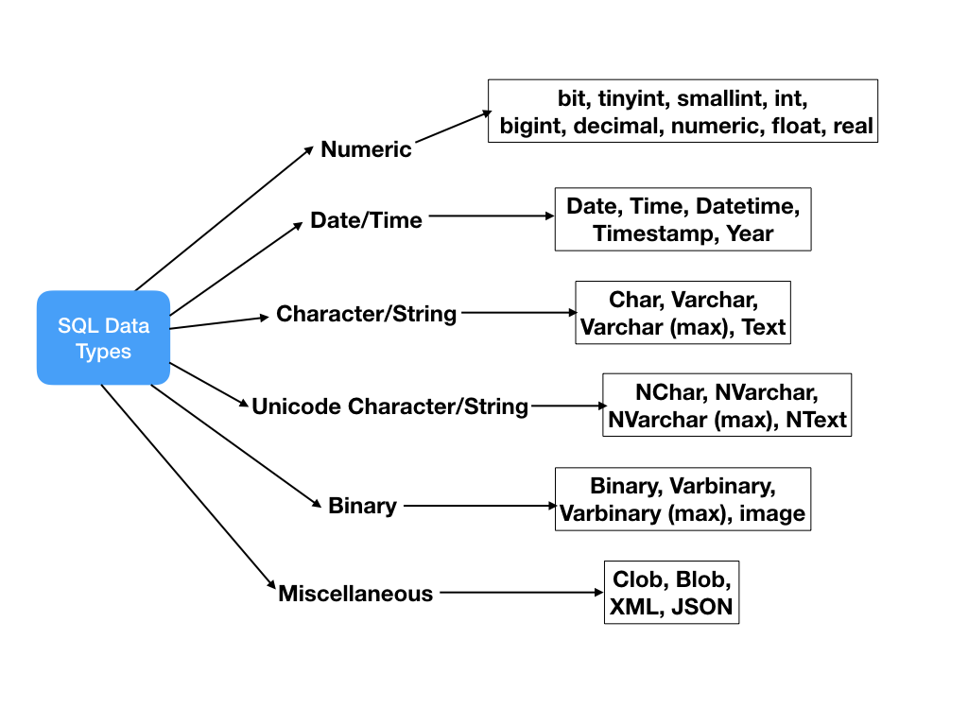
What data types can you use?
Tutorial: https://www.tutorialspoint.com/mysql/mysql-data-types.htm

Slide 10
SQL Functions
Aggregate functions: Avg, Count, INSTR, Sum, Min/Max
String functions: Concat, Length, Left, Replace, Substring, Trim, Format
Control flow functions: Case, if, ifnull
Date and Time functions: Curdate, DateDiff, Day/Month/Year, DateAdd, now
Comparison functions: Coalesce, isnull
Math functions: Ceiling/Floor, Round, Truncate
Data Types: CAST
Tutorial: http://www.mysqltutorial.org/mysql-functions.aspx
Notes:
Aggregate Function: aggregate function performs a calculation on a set of values and returns a single value.

Slide 11
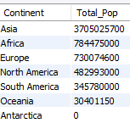
Example - Continent Query
What is the total world population by continent?
SQL Query
SELECT Continent, sum(Population) as Total_Pop
FROM world.country #“what schema/table to read”
GROUP BY continent #“often needed to summarize by group”
ORDER BY continent DESC #“Sort rows in result”
Notes:
Format for readability
FROM: what table to read
SELECT: what columns to get
AS: rename the column
GROUP BY: combine rows by column value
ORDER BY: sort in ascending or descending order
LIMIT: constrain the number of rows displayed

Slide 12
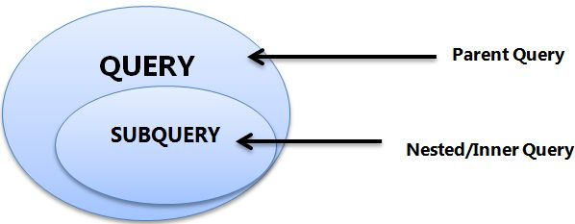
Subqueries
A.K.A. nested queries, inner queries, inner select
Must be enclosed by parentheses
Ex: SELECT <col> FROM <table>WHERE (SELECT <col> FROM <table>);
Can return single value (aka scalar), single row, single column, or table
Evaluated inside-out

Slide 13

Example - World Query
What is the total population of the continent of Asia?
SQL Query
SELECT subq.Continent, sum(subq.Population) as Total_Pop
FROM (
select Continent, Name as Country, Population
from world.country
where Continent = 'Asia'
) as subq #using subquery
group BY subq.Continent
Subqueries are often used to return a subset of an entire dataset!
Notes:
Format for readability
FROM: what table to read
SELECT: what columns to get
AS: rename the column
GROUP BY: combine rows by column value
ORDER BY: sort in ascending or descending order
LIMIT: constrain the number of rows displayed

Slide 14
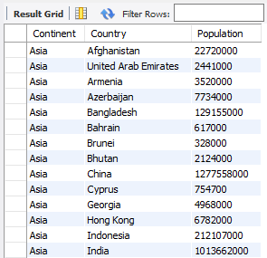
How did it work?
SQL SubQuery
Summarize the Population of all Asian
Countries by Continent

Slide 15
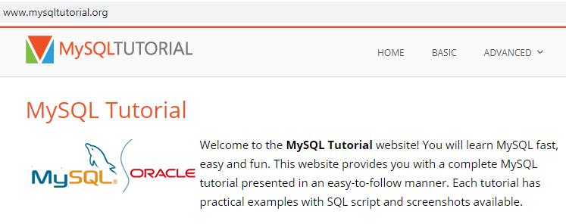
Resources
References
Data types primer
Aggregation primer
Subquery primer
Practice:
SQLZOO
CodeWars
(SQLite 3.2.8, PostgresSQL 9.6)
HackerRank
(DB2, MySQL, Oracle, MS SQL Server)
Data.world
Google BigQuery

Slide 16

Exercises
World Schema
1. In world.city, What are the names and CountryCodes of all countries in the database (sorted alphabetically by code)?
2. Return the names of all cities contained in the world.city table that are in the united states.
3. Find the total population of all USA cities that are in the world.city table
4. Return the names of all cities contained in the world.city table that are in Nebraska (Region), using a subquery
5. In the world.country langage table, select all countries where the official language is ‘English’
6. In the world.country table, compare the average life expectancy of people, in a variety of ways.

Slide 17

Class Project
Business Understanding - Queries
1. Based on the collected console data, what is the newest platform in our dataset and what year was it first available?
2. Which console had the longest lifespan (in years)?
3. Based on game data, which country has the most video game sales, over all platforms?
4. How many video games were produced for the NES platform?
5. What Genre of games had the most unit sales for the XBox 360 system?
6. Overall, what is the most popular genre of games, by unit sales?
7. Based on this information, what type of game and/or console would you recommend to management?

